Slide 1
Echo In The Dark
By Adrian Carter

Slide 2
Synopsis
Far in the future, Robots are mass produced on Space stations that orbit Earth.
You play as a small defective engineering robot with malfunctioning optical sensors, discarded and doomed to be recycled.
You escape destruction in the tutorial level and must use Sound Waves to guide your escape of the station.

Slide 3
Player Mechanics
An intermittent pulse of sound projects in a cone from the front of the player every 2 seconds.
Each pulse highlights empty space in the direction the player is facing (objects, walls and floors etc. will remain black)
With physics based movement, the player controls thrusters on the character to change horizontal and vertical speed and momentum.

Slide 4
Rules
Don’t bash into anything!
The robot is already damaged and thus very fragile, any collisions with enough force could make its reactor core go critical.
Escape as quickly as possible. Levels will be timed and extra points awarded based on how quickly you can find the exit. With limited vision, players will be forced to take risks to get the fastest times.

Slide 5
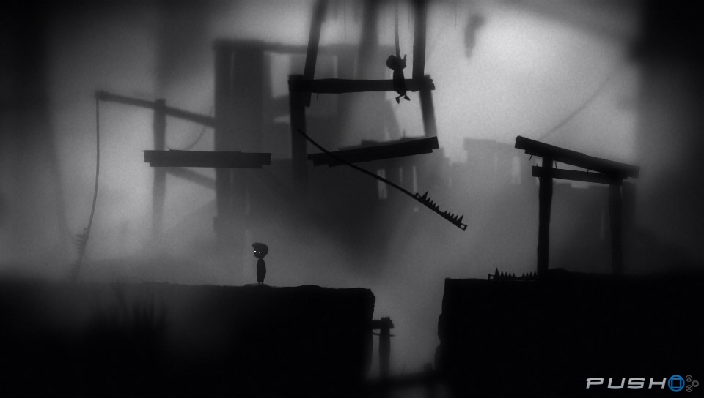
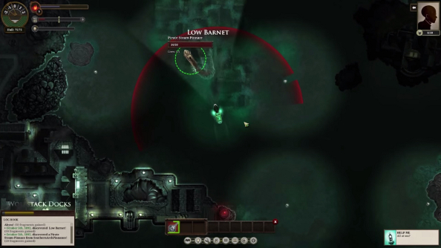
Level Design
30 levels, different each play through.
Each level procedurally generates 4 different connected rooms based on a 3x3 layout.

Slide 6
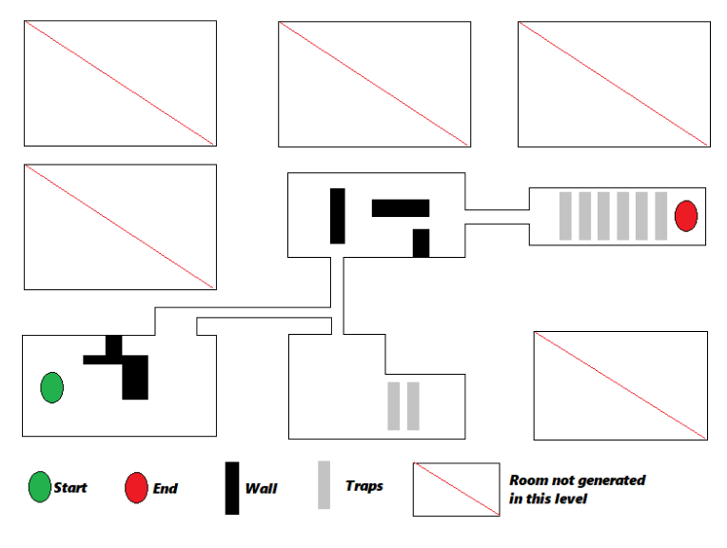

Slide 7
Level Design
30 levels, different each play through.
Each level procedurally generates 4 different connected rooms based on a 3x3 layout.
Each individual room is designed with varying traps and moving obstacles to avoid.
Later levels generate more difficult rooms to increase the challenge.
Minimalist and atmospheric art style like in Limbo and Sunless Sea. Mostly in black and white.

Slide 8
Overview
Difficult top down 2D game.
Simple controls, hard to master.
Jetpack-like 2D propulsion physics.
Each pulse lights up the empty space in a cone of vision in front of the player. (like Daredevil)
Procedurally Generated levels.

Slide 9
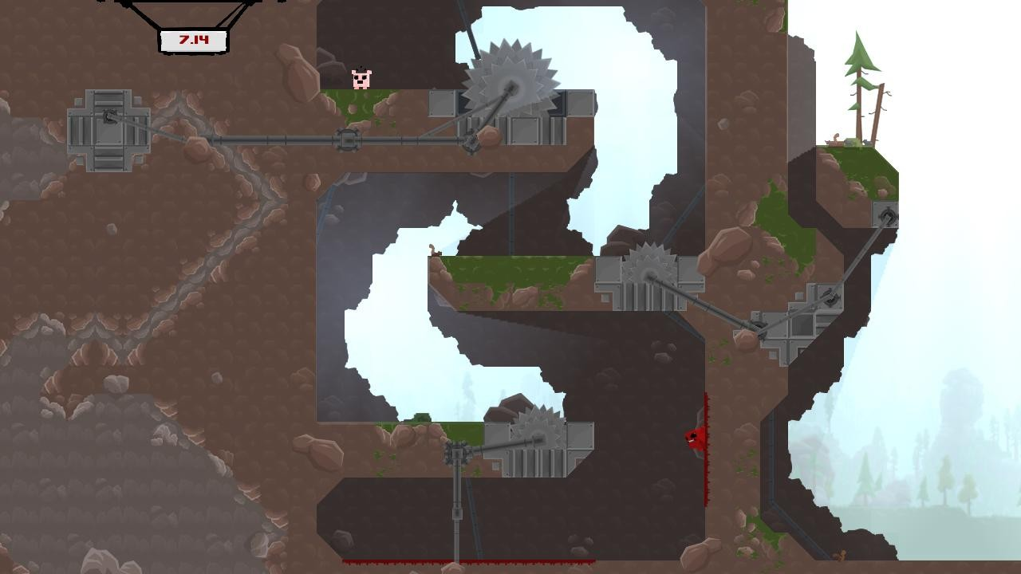
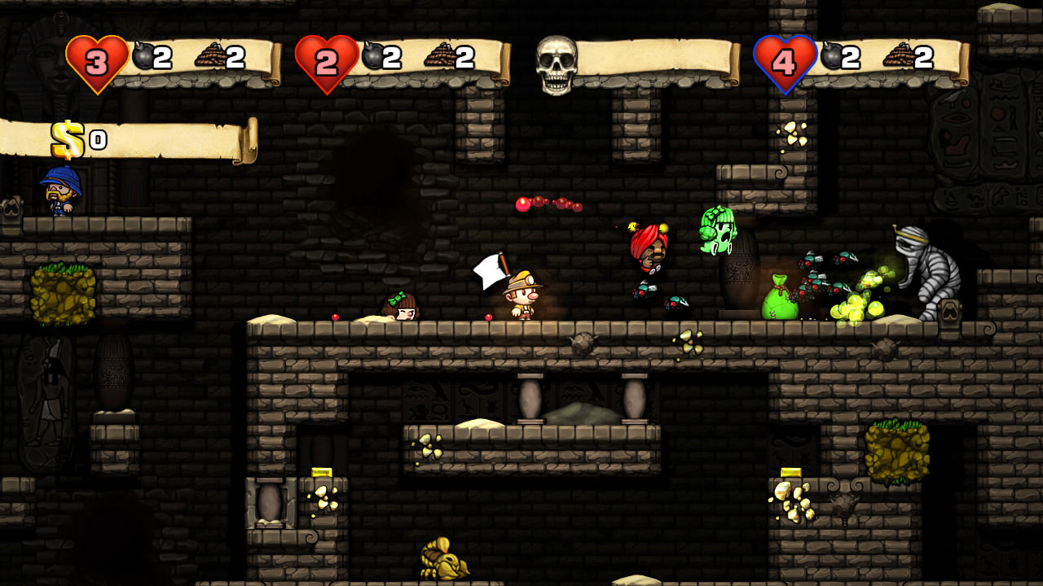
Target Market
16 – 30 year olds.
Hardcore Gamers with fast reflexes who enjoy a challenge.
Speedrunners.
Gamers who enjoy difficult games like Super Meat Boy and Spelunky.

Slide 10
Production Time and Costs
I predict the game will take a year to make.
4 team members at £30,000 a year = £120,000.
£5,000 for promotion and marketing.
£1,000 a month for office upkeep = £12,000.
£3,000 for computer software and hardware.
Total: £140,000
To break even at RRP of £6.99, 20,029 units must be sold. Planned for release on Steam and Itch.io.

